Slide 1
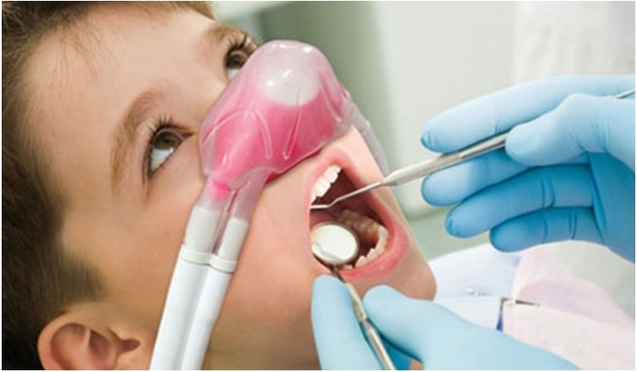
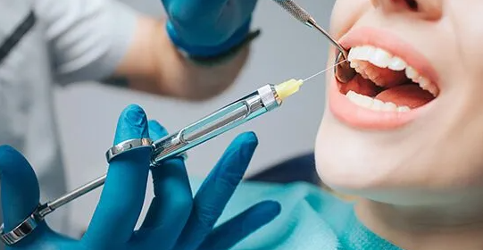
Dental Anesthesiology
General anesthesia
Local anesthesia

Slide 2
Dental anesthesiology
is a specialized field within dentistry that focuses on providing anesthesia services to patients undergoing dental procedures. Dental anesthesiologists are highly trained professionals who work along side dentists and other dental specialists to ensure patient comfort, safety, and pain management during various dental treatments
From local anesthesia, minimal sedation, moderate sedation, deep sedation and general anesthesia

Slide 3
Local Anesthesia for dental anesthesiology
Local anesthesia is a commonly used technique in dental anesthesiology to provide pain relief and numbness in a specific area of the mouth during dental procedures. It is the mildest form of anesthesia and is frequently employed for minor dental treatments, such as filling cavities, extracting single teeth, or administering dental cleanings.
The primary goal of local anesthesia is to block the transmission of pain signals from the nerves in the targeted area, allowing the patient to remain awake and responsive during the procedure.
Administration of Local Anesthesia: The dental anesthesiologist or dentist administers local anesthesia through an injection near the site of the dental treatment. The local anesthetic solution typically contains lidocaine or articaine, which are fast-acting and provide effective pain relief.

Slide 4
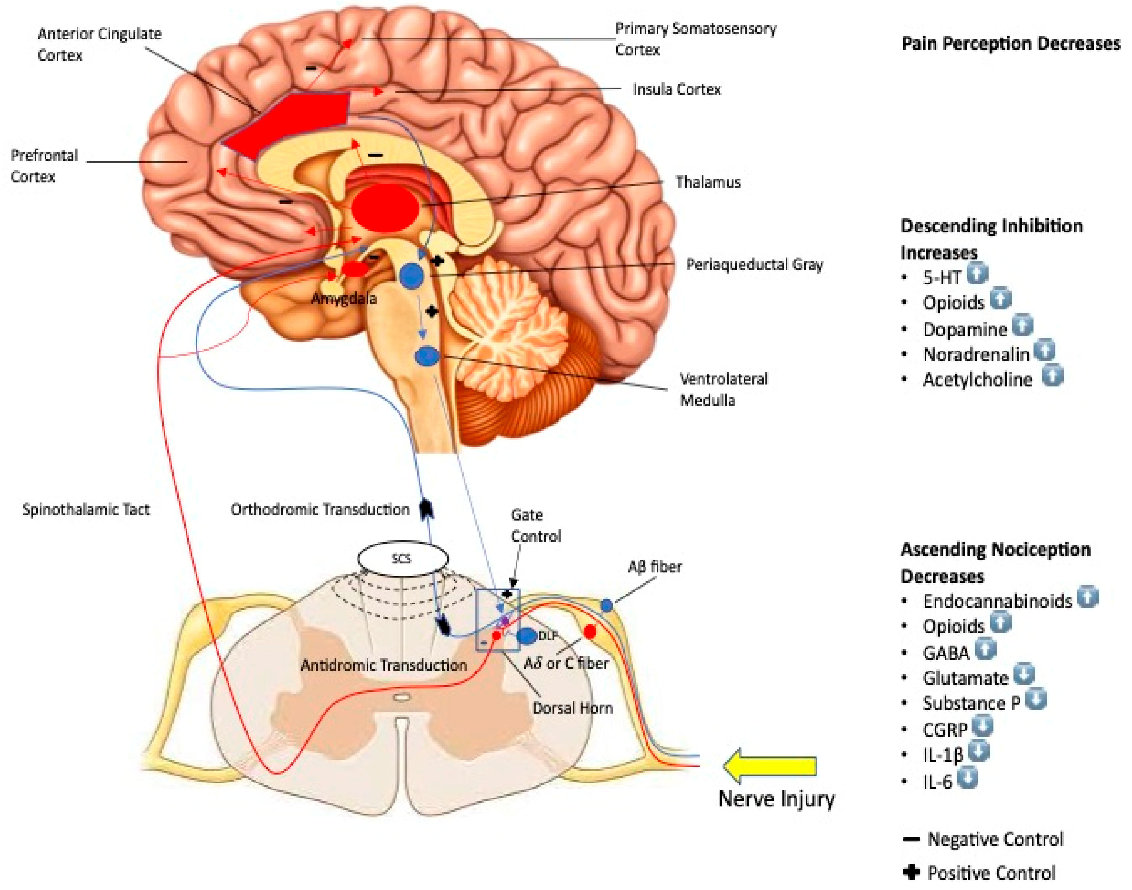
Nerve stimulus transmission

Slide 5
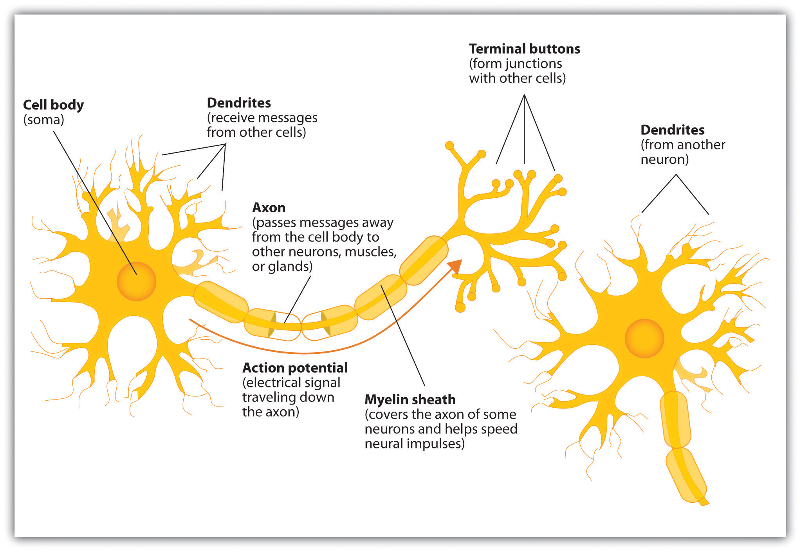
Local anesthetics
block nerve conduction by preventing the increase in membrane permeability to sodium ions that normally leads to a nerve impulse. Among anesthetics containing tertiary amine groups, the cationic, protonated form appears to be more active than the neutral form.

Slide 6
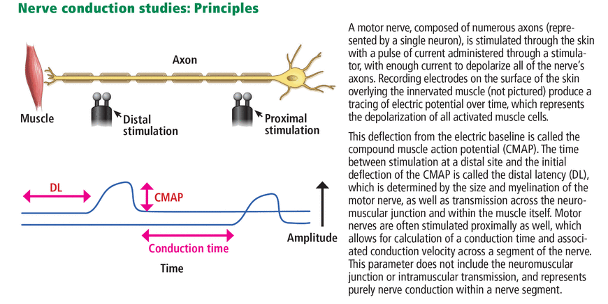
Nerve stimulation blockage

Slide 7
Local Anesthesia for dental anesthesiology
Numbing Effect and Duration: Once the local anesthesia is administered, the patient will begin to feel numbness in the treated area within a few minutes. The numbing effect may last for a few hours, depending on the specific type and dosage of the anesthetic used. After the procedure is complete, the numbness gradually wears off, allowing the patient to regain normal sensation.

Slide 8
Benefits of Local Anesthesia:
Local anesthesia offers several advantages in dental procedures:
1.Pain Relief: The main benefit of local anesthesia is its ability to provide effective pain relief during dental treatments, making the procedure more comfortable for the patient.
2.Limited Systemic Effects: Local anesthesia is site-specific, meaning it affects only the treated area and has minimal impact on the rest of the body. As a result, the patient can remain fully awake and alert during the procedure

Slide 9
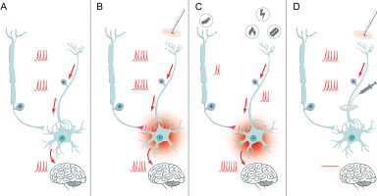
Nerve block

Slide 11
1.Fast-Acting: Local anesthesia takes effect quickly, allowing the dental procedure to begin promptly once the anesthetic is administered.
2.Controlled Dosage: Dental anesthesiologists can adjust the dosage of the local anesthetic to suit the patient’s needs, ensuring adequate pain relief without excessive numbness.
3.Safety Profile: Local anesthesia is generally safe and well-tolerated by most patients. Serious side effects are rare, and dental anesthesiologists carefully consider any potential risks before administration.
Considerations and Precautions: While local anesthesia is considered safe, certain patients may have allergies or sensitivities to the anesthetic agents. Dental anesthesiologists perform thorough patient evaluations to identify any contraindications or potential risks before administering local anesthesia.
In conclusion, local anesthesia is a valuable tool in dental anesthesiology, providing effective pain relief and enabling dental procedures to be performed with enhanced patient comfort. Its targeted and controlled effects make it a commonly used technique for minor dental treatments in both pediatric and adult patients.

Slide 12
Local Anesthesia

Slide 13
Local anesthesia
Pharmacology
Principles and mechanism
Classification
Cartridge contents
Calculations
Adverse effects
Techniques
Maxillary
Mandibular
Secondary

Slide 14
Pharmacology of local anesthesia
Two factors involved in the action of a local anesthetics are
Diffusion of the drug through the nerve sheaths
The binding at the receptor site in the ion channel

Slide 15
Local Anesthetics exists in
Ionized (RNH+) that will blick the inactivated Na channel
Non ionized forms is the form that is capable of diffusing across nerve membranes
The proportion of which vary with the pH of the environment

Slide 16
Inside the cell, pH is acidic secondary to metabolism
RNH2 + H = RNH3+
When tissue condition Are normal pH 7.4, Approximately 10-20% portion of an infiltrated local anesthetic is in form of free base (non-ionized form). This is enough to penetrate the nerve to cause anesthesia
Local anesthesia work by blocking the flow of sodium ions, thereby preventing depolarization of the nerve fibers and conduction or transmission of impulse
Potassium, calcium and chloride conductance’s remain unchanged

Slide 17
The extent of anesthesia depends on a variety of factors
the amount of medication used
Body temperature
pH
The amount of protein binding
Dilution by tissue fluids

Slide 18
The duration of action of local anesthetics is
Directly proportional to protein binding and lipid solubility
Increased protein binding and increased lipid solubility = increased duration of action
The lower the pKa (dissociation constant) of the local anesthetics, the faster the onset of action. The acid dissociation constant (Ka) of a solution is pKa, the negative base-10 logarithm. The pKa value is one method of determining an acid's strength. A lower pKa value denotes a more powerful acid. For example, a lower number indicates that the acid dissociates more entirely in water.

Slide 19
Factors | Action affected | description
pKa | Onset | Lower pKa = more rapid onset of action, the more RN( free base form) molecules present to diffuse through nerve sheaths thus the onset decreased
Lipid solubility | Anesthetic potency | Increase in lipid solubility = increase potency (eg. Procaine = 1; etidocaine = 140) etidocaine produces conduction blockade at a very low concentrations, whereas procaine poorly suppresses nerve conduction, even at higher concentration
Protein binding | Duration | Increase protein binding allows anesthetic cations (RNH+) to be more firmly attached to proteins located at receptor sites, thus duration of action is increased
Non-nervous tissue diffusibility | Onset | Increased diffusibility = decreased time of onset
Vasodilator activity | Anesthetic potency and duration | Greater vasodilator activity = increased blodd flow to the region = rapid removal of anesthetic molecules from the injection site; thus decrease anesthetic potency and decreased duration

Slide 20
Important points
A local anesthetic with a low pKa has a very large number of lipophilic free base molecule that are able to diffuse through the nrce membrane
Increased blood flow means shorter duration of action

Slide 21
Sensation in increasing order of resistance to conduction
Pain
Cold
Warm
Touch
Deep pressure
Motor
Note: nerve regain function in reverse order

Slide 22
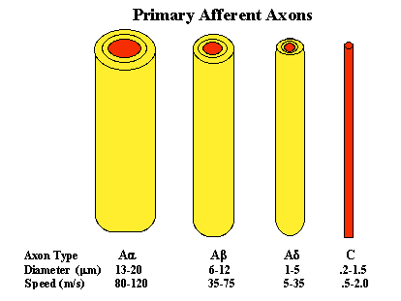
Four types of nerve fibers
These primary afferent axons come in different diameters and can be divided into different groups based on their size. Here, in order of decreasing size, are the different nerve fiber groups: A-alpha, A-beta, A-delta and C-nerve fibers. A-alpha, A-beta and A-delta nerve fibers are insulated with myelin.

Slide 23
Differential blockade
Local anesthetics causes loss of sensation by first blocking nerve conduction in smaller unmyelinated fibers that carry pain, then progressing to the larger myelinated fibers for pressure and motor function. This phenomenon is called differential blockade
The smallest axons, surrounded by columns of Schwann cell processes, are the non-myelinated nerve fibers and are the most common. Larger axons are surrounded by a sheath of myelin, a lamellar condensation of the Schwann cell cytoplasm and are hence termed myelinated nerve fibers.

Slide 24
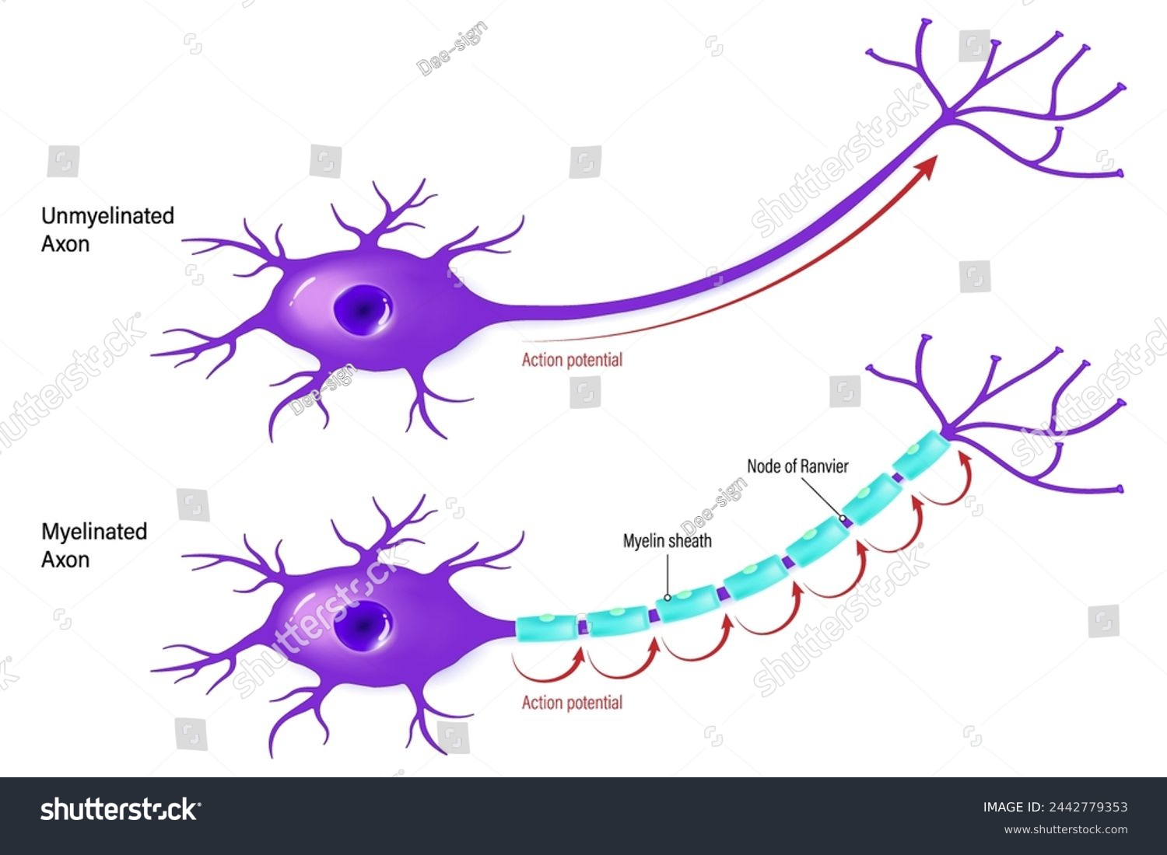
Myelinated vs unmyelinated nerve sheaths

Slide 25
Differential blockade maybe due to the:
Size of the nerve (smaller diameter are blocked first)
The presence or absence of myelin sheaths (myelinated of same size are blocked first)
Firing frequency (higher frequency excited nerves blocked first)

Slide 26
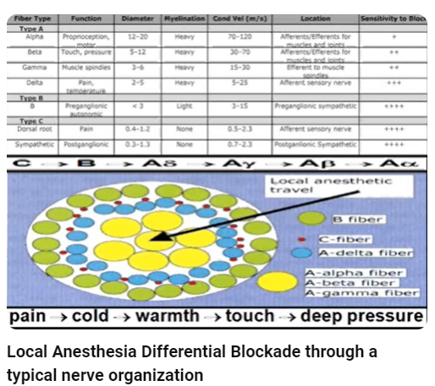
Differential blockade

Slide 27
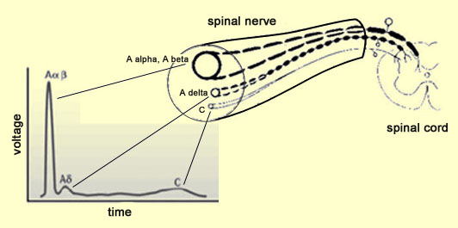
A.Size of the Nerve
Local anesthetics preferably block small fibers because ethe distance over which such fibers can passively propagate an electrical impulse is shorter. During the onset of the local anesthesia, when short sections of nerve are blocked, the small diameter fibers are the first to fail to conduct.

Slide 28
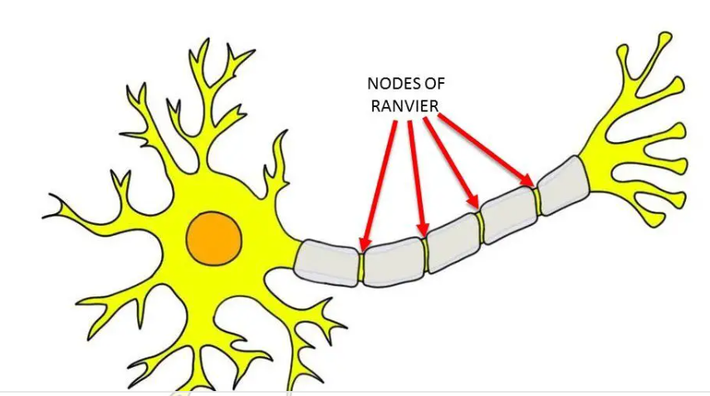
B. Presence or absence of Myelin Sheaths
For myelinated nerves, three successive nodes of Ranvier must be blocked to halt the impulse propagation
The thicker the nerve fiber, the farther apart the nodes tend to be which explains the greater resistance to block of large fibers.eg. motor fibers to the skeletal muscles

Slide 29
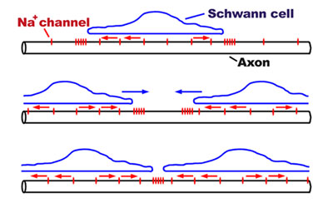
Presence or absence of Myelin Sheaths
Myelinated fibers tend to become blocked before unmyelinated fibers of the same diameter
Sodium channels are very dense at the nodes of ranvier in myelinated fibers of the same diameter

Slide 30
C. Firing frequency
Sensory fibers , especially pain fibers, have a high firing rate and relatively long action potential duration
Firing rate refers to the rate at which neurons in the brain generate electrical impulses, which can be understood as a reflection of the decision-making process based on the time taken for the firing rate to reach a threshold value and the growth in activity predicting decision time.
Motor fibers fire at a slower rate and have a shorter action potential duration
An action potential is a rapid sequence of changes in the voltage across a membrane. The membrane voltage, or potential, is determined at any time by the relative ratio of ions, extracellular to intracellular, and the permeability of each ion.
A delta and C fibers are small diameter fibers that participate in high frequency pain transmission. Therefore, they are blocked sooner with lower concentrations of local anesthetics than A alpha (motor) fibers in skeletal muscle

Slide 31
Classification of Local Anesthetics
Amides
All have an amide grouping within their chemical structures
An amide grouping is essentially a bridge or link containing the -CONHCH2- configuration
Esters
All have an ester grouping within their chemical structure
An ester grouping essentially a bridge or link containing the –COOCH2- configuration
Others

Slide 32
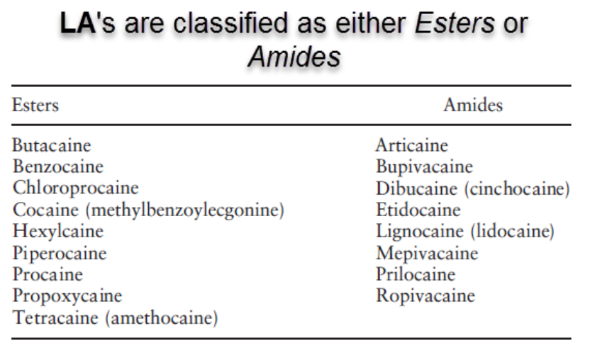
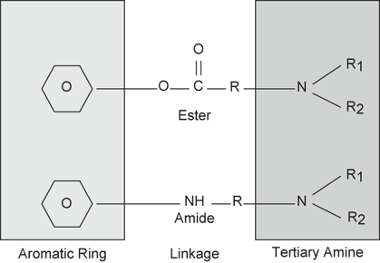
Types of Local Anesthetics
Amides | Esters
Lidocaine (Xylocaine) | Benzocaine
Mepivacaine (Carbocaine) | Procaine
Prilocaine (Citanest) | Tetracaine
Bupivacaine (Marcaine) | Dibucaine
Articaine (Septocaine) | Propoxycaine
Etidocaine Lidocaine (Lignocaine) Dibucaine (Cinchocaine) Ropivacaine

Slide 33
Amides
Metabolism
Protein binding
Drug interactions

Slide 34
Amides : Metabolism
Amides are primarily metabolized in the liver by the hepatic enzyme system (liver amidases)
The products formed do not have anesthetic actions and are excreted primarily in the urine as metabolites
Use with caution in patients with compromised liver function
The most abundant urinary metabolite of lidocaine is 4-hydroxyxylidine
Amides are safer, versatile and effective local anesthetics

Slide 35
Amides are metabolized by three types of reactions:
Dealkylation of the amino terminus
Hydrolysis of the amide bond
Hydroxylation of the aromatic ring

Slide 36
Protein binding of amides
The amide vary in protein binding
Lidocaine and mepivacaine are bound moderately
Etidocaine and bupivacaine are highly bound
Bupivacaine has the longest duration of action

Slide 37
Drug interactions:
Lidocaine has serious drug interactions with beta blockers and cimetidine that decrease lidocaine clearance 30% or more
Beta blockers decrease cardiac output results in reduced liver blood flow
Cimetidine decreases lidocaine clearance by inhibiting hepatic microsomal enzymes.
Lidocaine may be accelerated by concomitant use of phenobarbital and phenytoin

Slide 38
Drug interactions:
Prilocaine is metabolized to orthotoluidine, a product that can produce methemoglobinemia
Methemoglobinimia is less effective than hemoglobin in carrying oxygen in the blood thus
Prilocaine is NOT USED for patients with hypoxic conditions of any kind
Produce less vasodilation than do equal amount of lidocaine
The local anesthetics lidocaine and prilocaine are recommended for pregnant women

Slide 39
Drug interactions:
Articatine is an amide local that has ester group attached to its molecule which can be acted upon by plasma cholinesterase to render it ineffective
It is the only amide whish is metabolized in the bloodstream and NOT the liver
It is CONTRAINDICATED in patients with hypersensitivity to local anesthetics of the amide types or to bisulfite.

Slide 40
Drug interactions:
Mepivacaine usually plain and causes the least vasodilation

Slide 41
Ester
Procaine (Novocaine) was at one time the most commonly used ester local anesthetic in dentistry. It is the prototype for the ester group local anesthetics but no longer available in dental cartridge form
Metabolized by the plasma enzyme cholinesterases/pseudocholinesterases.
Maily available as topical anesthetics
Esters are no longer available as injectable local anesthetics because of their relative high incidence of allergy.
When procaine is metabolized by the plasma cholinesterases, a highly allergic compound PABA – para-aminobenzoic acid is formed. Many patients develop allergy to PABA

Slide 42
Ester
Cocaine is the first ester local anesthetics in dentistry
Potent and extremely toxic and it is the only local anesthetics that causes definite vasoconstriction
Blocks re-uptake of cathecholamine >> increase Ne>>increase vasoconstriction

Slide 43
Other chemicals that act like Local Anesthetics
Diphenhydramine : H1 antihistamine
Tetrodoxin
Saxitoxin

Slide 44
Local anesthetic reversal
Phentolamine mesylate (Oraversed) is the drug used to reverse local enesthetic effects by causing vasodilkation thus increase blood flow in the injection site
Phentolamine mesylate is an alpha1 adrenergic receptor blocker
50 % decrease in the time for normal sensation to return

Slide 45
Cartridge : content of LA carpule of lidocaine
Lidocaine
Vasoconstrictor like epinephrine
NaCl: isotonicity of the solution
Sodium metabisulfite: antioxidant
Methylparaban : bacteriostatic agent
Sterile water

Slide 46
Vasoconstrictor:
Such as epinephrine and levonordefin are used because they:
Prolong the duration of action
Reduce toxicity by delaying the absorption of anesthetic into circulation
Reduce rate of vascukar absorption
Provides hemostatic effect to reduce bleeding at injection site
The use of vasopressor containing LA also may actually lower pH of the solution to between 3.3 and 4, significantly more acidic than solutions not containing vasopressor (pH about 5.5)
Patients are more likely to feel the burning sensation with these solutions

Slide 47
Metabisulfite
An antioxidant that protects the vasoconstrictor from oxidation
It has a low incidence of allergenicity
Preparation such as mepivacaine 3% do not contain bisulfite

Slide 48
Methyparaben
No longer included in single use dental cartridges of LA, however, it is found in all multidose vials of injectable drugs

Slide 49
Calculations: Recommended Maximum doses of LA with vasoconstrictors
Drug | Maximum Dose | Max # of Cartridge
Articaine | 7 mg/Kg (up to 500 mg) 5 mg/Kg in children | 7
Bupivacaine | 2 mg/Kg ( up to 90 mg) | 10
Lidocaine | 7 mg/Kg (up to 500 mg) | 13
Mepivacaine | 6.6 mg/Kg (up to 400mg) | 11 (or 7 if plain)
Prilocaine | 8 mg/Kg (up to 500 mg) | 8

Slide 50
Lidocaine 2%, volume 1.8 ml contains 36 mg of LA
1 ml of 1% LA contains >> 10 mg of LA
1 ml of 2% LA contains >>> 20 mg of LA
1. ml of 2% LA contains >> 36 mg of LA

Slide 51
Epinephrine limit in healthy patient is >>0.2 mg
1:100,000 >> 0.018 mg >> 11 carpules
1:200,000 >>0.009 mg >> 22 carpules
1:50,000 >> 0.036 mg >> 5.5 carpules

Slide 52
Epinephrine limit in CVS patient is >>0.04 mg
1:100,000 >> 0.018 mg >> 2 carpules
1:200,000 >>0.009 mg >> 4 carpules
1:50,000 >> 0.036 mg >> 1 carpules

